Slide 1
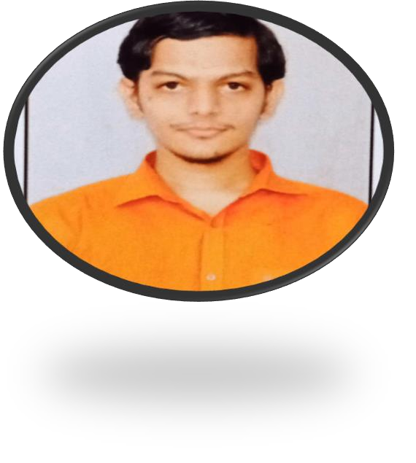


SAINIKHIL GODLAVETI
Education and certificates
BACHELOR OF ENGINEERING
Electronics and Communication Engineering:2017-2021
Analyst/Software Engineer
Base Location: BANGALORE
Email ID: Sainikhil.godlaveti@capgemini.com
Mobile No: +91 7036404155
Skills
C#
Dot net core ADO. Net
ASP. Net Core MVC Python
Pandas
Data Wrangling
Grade:
A4
Strengths
Achivement
Online Recipe Ingrediant Management System :
Completed end to end case study of Online Recipe
Ingrediant management System along with Swagger. html, CSS for user interface.
Database
MS SQL Server 2014
Eager to work in a team of dedicated people and serve a key role in the enhancement and development of the project.
AddOns Github Postman
Ready to learn new technologies and implement them to further improve my knowledge.
Completed Microsoft Azure Fundamentals Certificate
Additional skills Quick Learner Team Management
Had working experience in Data science technology and am more eager to explore my knowledge in that technology.
Completed Python Data Science Certification
Github

